Slide 1
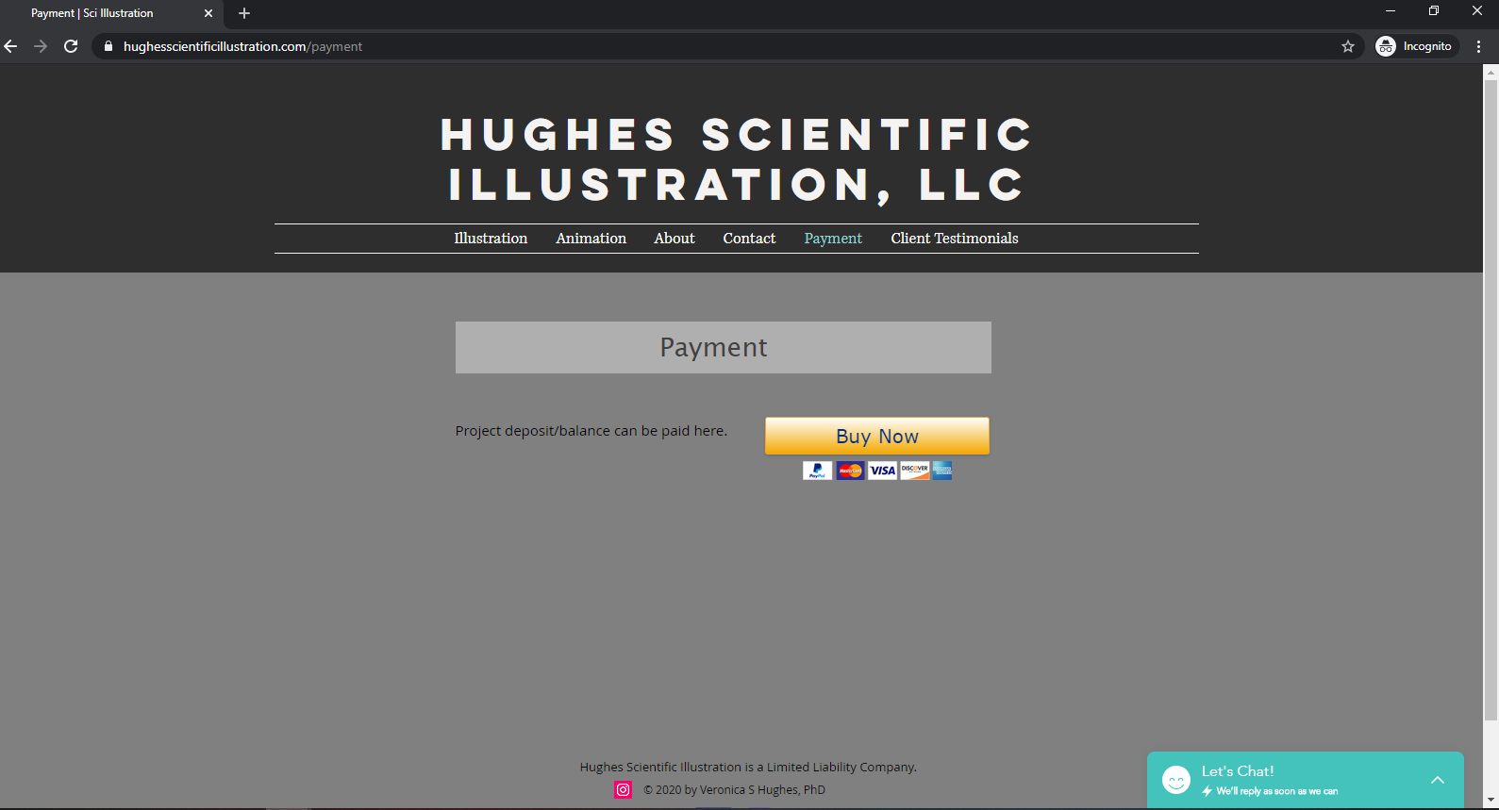
Click here

Slide 2
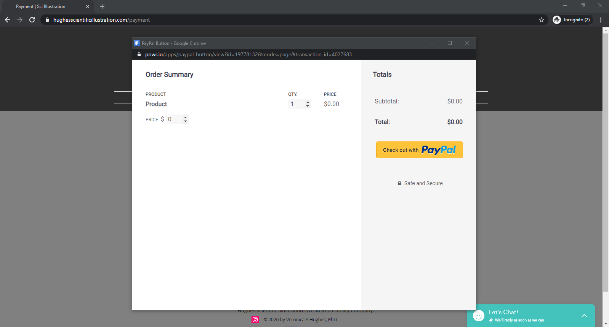
Enter the appropriate amount here, then click the yellow “Check out with PayPal” button

Slide 3
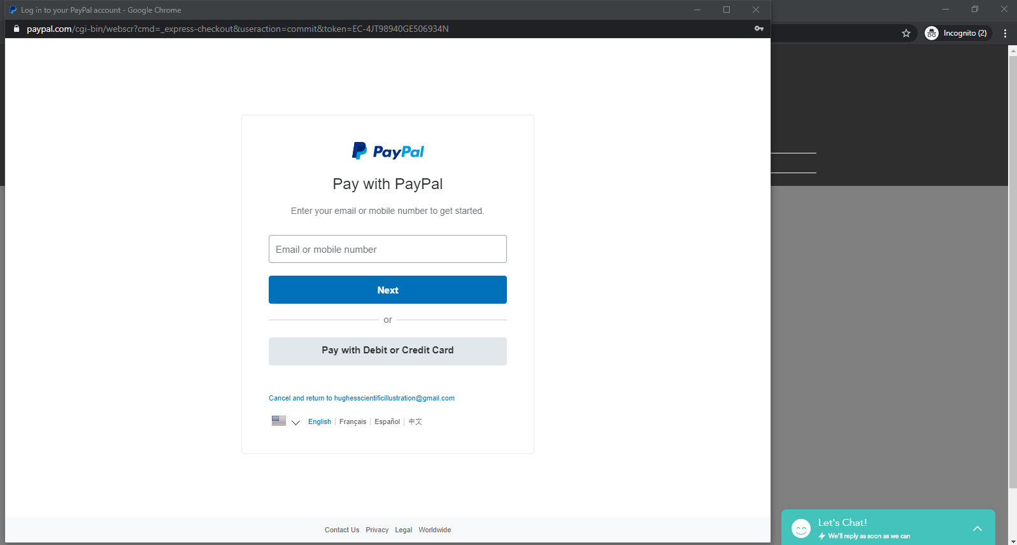
If you do not wish to use a PayPal account, click here, which will take you to guest checkout

Slide 4
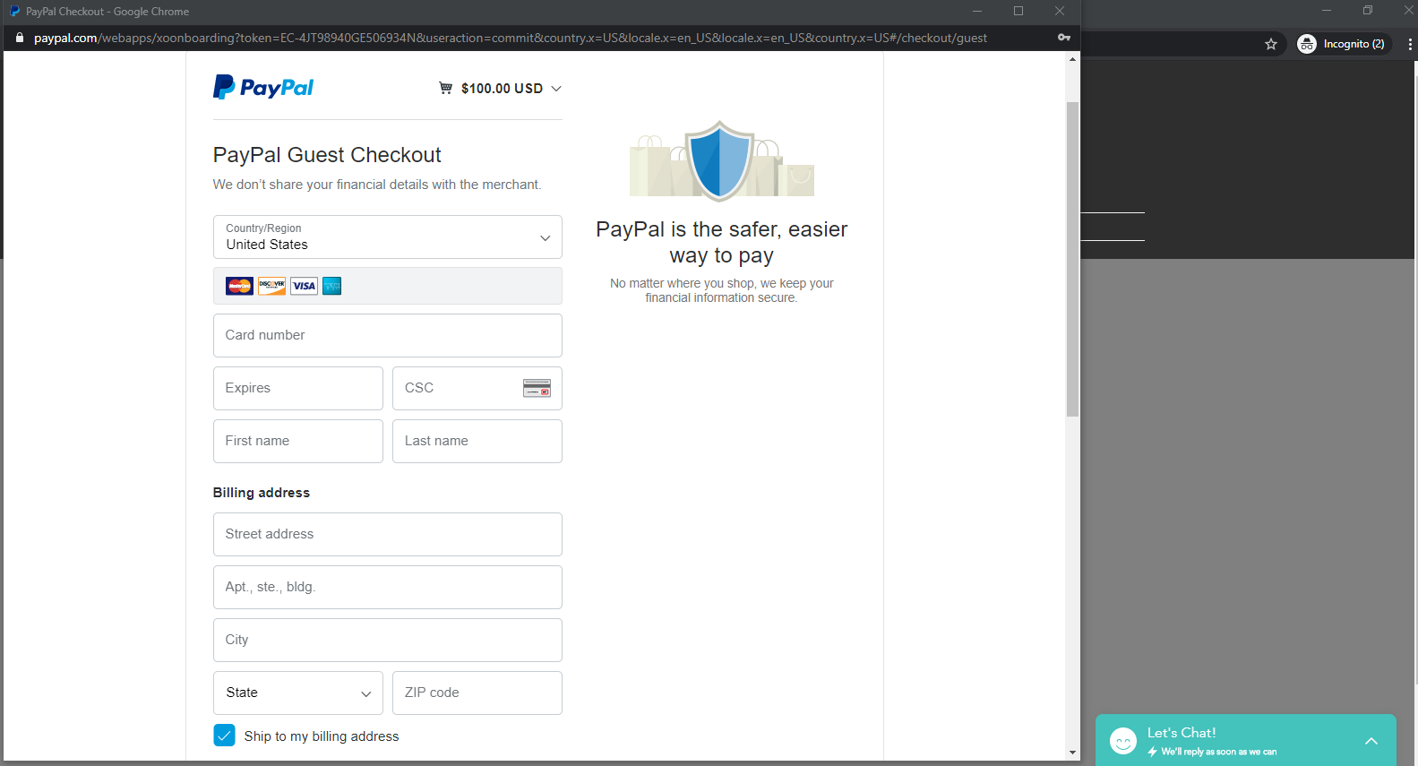
Enter your credit card information on this page

Slide 5
If you still experience problems, please reach out to me! Thank you for your business.

